Slide 2

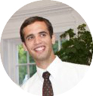

Beyond Bitcoin: Creative Destruction Through the Blockchain
Clayton
Rothschild
Mika Sanchez
Clayton Rothschild and Mika Sanchez

Slide 3
Introduction and Roadmap
We are here to talk about Blockchains
How do they work?
Why are they great?
What can we create?
Bitcoin
Blockchain
Demo
Fin.
Notes:
Roadmap Slide -> Something im passionate about. Blockchain. SOO we are going to explain what the blockchain is. But. To do that we are going to tlak about bitcoin, how bitcoin works, and what else can we create?
How do they work?
Why are they great? “Beyond Bitcoin”
What can we create? “Creatve Destructoin through the blockchain”

Slide 4
Bitcoin
Notes:
Most material discussing blockchains stems from Bitcoin. So, in order to get a good understanding of what blockchains are, what they do, and what they are capable of let’s use Bitcoin as a case-study.

Slide 5
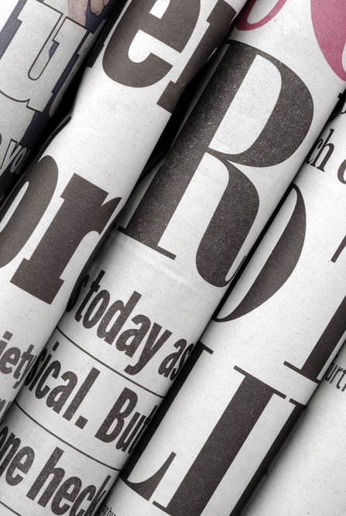

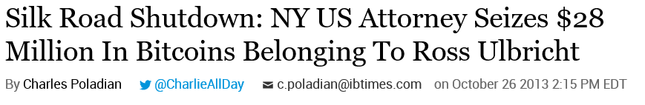

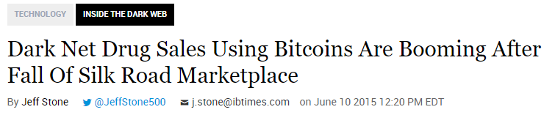
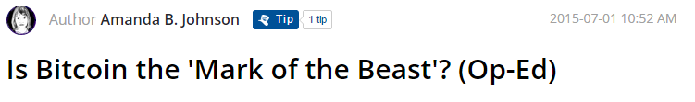
What is Bitcoin?
Notes:
When people first hear the word Bitcoin, a number of items pop in their head:
Bitcoin is only used to purchase drugs!
Bitcoin is used by criminals to launder money.
Bitcoin is some libertarian experiment to subvert the governments’ control on money.
Or, my favorite and perhaps the most pertinent:
Bitcoin still exists?
Indeed, Bitcoin still exists, and it’s uses are many. But before we discuss the uses of Bitcoin, we want to discuss what it is and how it works. And, after we understand how exactly the technology works, we will quickly see that all of a sudden that the most exciting part of Bitcoin is not bitcoin itself, but what else can be created with this technology.

Slide 6
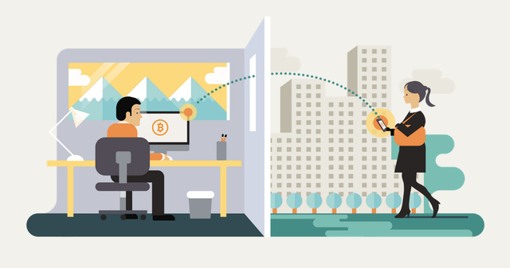
Bitcoin is like email for money.
Notes:
So, lets begin, with a basic, explain-like-I’m-five, understanding of bitcoin. It is this:
“Bitcoin is like email for money. It is both a currency, and a payment network - kind of like the US dollar and Visa combined.”
In the same way that a user may send an email from one email address to another, someone may send bitcoin from one address to another user. Email, like Bitcoin, is transactional. Each email sent is one record, or transaction, in a database. However, the similarites to email end there...

Slide 7
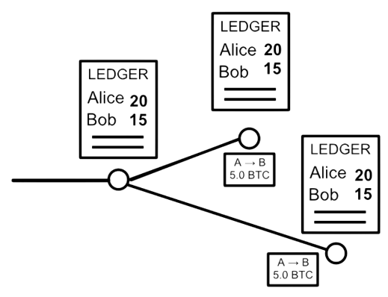
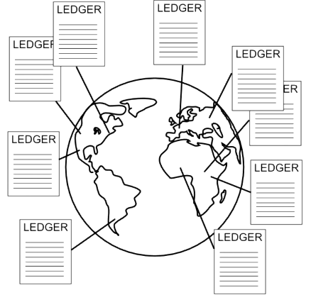
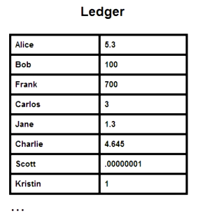
There is no Bitcoin Inc.
Bitcoin
Email
Notes:
Indeed, emails are transactional and tracked in a database. In the case of our Pariveda email address, our database is stored centrally, on our exchange server.
Bitcoin, rather than a database of emails, is a database of transactions. And rather than being stored on a single exchange server, it is stored on thousands of other servers.
At its core, bitcoin just a digital file that lists digital accounts and money - like a ledger. Show ledger image. A copy of this file is maintained on every computer in the network.
To send money, a single node will broadcast their transaction to the rest of the network - that the balance on the senders account should go up, and the balance on the receivers account should go up. Each node in the network applies that transaction to their copy of the ledger, and passes on the transaction to other nodes. Show node propogation image.
While this may sound similar to the way a bank maintains a ledger, the fact that the ledger is maintained by a group rather than a single entity introduces a number of important differences and considerations. Show distributed vs Paypal image.

Slide 8
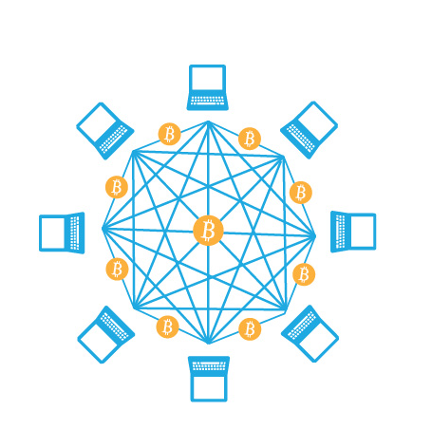
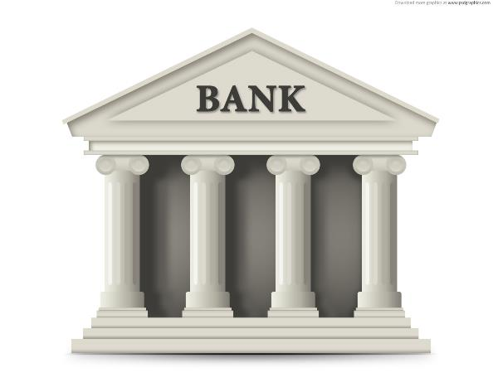
Bitcoin is decentralized
vs
Notes:
Indeed, emails are transactional and tracked in a database. In the case of our Pariveda email address, our database is stored centrally, on our exchange server.
Bitcoin, rather than a database of emails, is a database of transactions. And rather than being stored on a single exchange server, it is stored on thousands of other servers.
At its core, bitcoin just a digital file that lists digital accounts and money - like a ledger. Show ledger image. A copy of this file is maintained on every computer in the network.
To send money, a single node will broadcast their transaction to the rest of the network - that the balance on the senders account should go up, and the balance on the receivers account should go up. Each node in the network applies that transaction to their copy of the ledger, and passes on the transaction to other nodes. Show node propogation image.
While this may sound similar to the way a bank maintains a ledger, the fact that the ledger is maintained by a group rather than a single entity introduces a number of important differences and considerations. Show distributed vs Paypal image.

Slide 9
So, what’s the big deal?
A few things are very easy to prove in real-life but very difficult to do virtually:
Proving who you are
Proving what you own
Let’s take a look at how the blockchain helps us will all of those!

Slide 10
How can I prove it’s me?

Slide 11
Digital Signatures Provide Proof of Identity
Alice
Bob
Message
Message
Signing-key
Signature
Validation-key
Algorithm/Math Stuff
Algorithm/Math Stuff
Message really sent by Alice?
Signature

Slide 12
How can I prove I have something?

Slide 13
What is a Bitcoin?

Slide 14
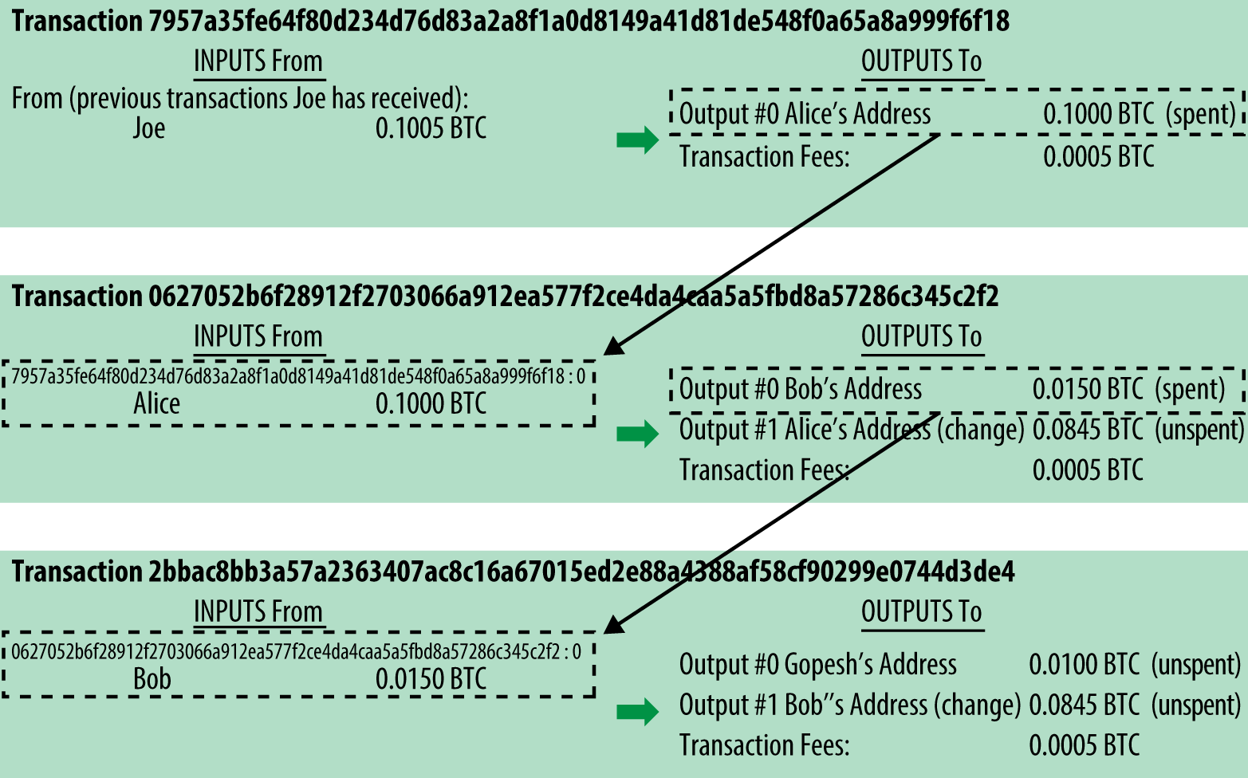
Transactions are the real base unit of the Blockchain
Transactions are made out of prior transactions
Notes:
Alice has:
- Validation/Private Key
- Signing/Public Key
- Wallet (Composed of Transactions that include her public address as an output)
*A Transaction can use multiple prior transactions as input
The inputs are digitally signed so that everyone knows that Alice really is the one sending the money.
But transactions by themselves don’t prove I have something!
How can I be sure that Alice hasn’t already spent what she has sent me?

Slide 15
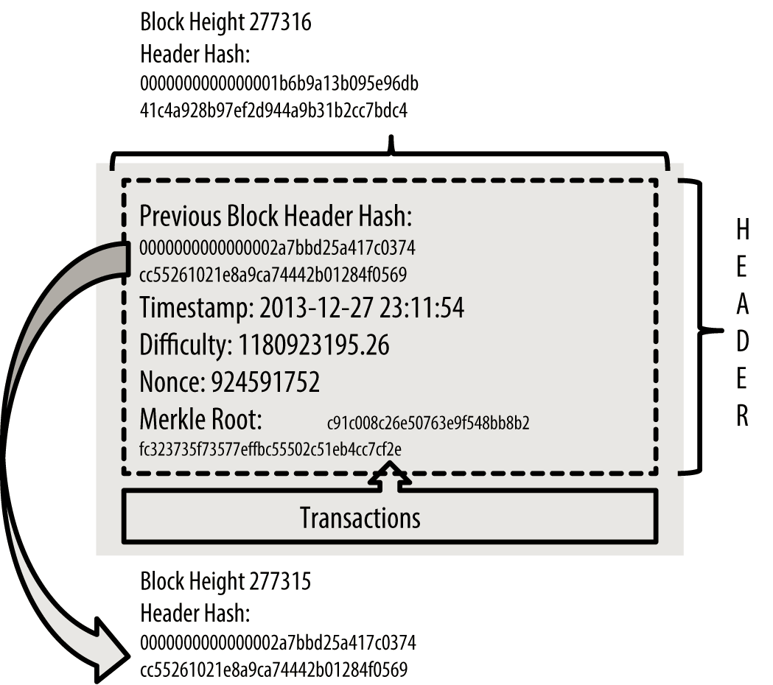
A Block Decomposed
Notes:
Blocks are the key! And more specifically the blockchain.
A node in the network takes all the pending transactions it knows about and combines them into a single “block”.
The new block contains a hash of the previous block that has been approved by the network.
This means that in order to change one transaction from the past, we would have to change all the blocks that come after it. This enables any node on the network to be able to tell immediately whether a block is valid or not.
But why couldn’t I just quickly go through the past blocks and make a bunch of changes and tell all the other nodes on the network that is really what happened?

Slide 16
Proof of Work
Challenge String
Proof String
Hashing Algorithm
Challenge Result
[0…000]a8fFb9nnH4
Notes:
Proof of Work makes it difficult to makeup a different history or chain of blocks because it is CPU intensive to make a single block.
The nice thing is that verifying whether someone has really done work or not is very easy to do.
This makes it extremely difficult for anyone to pretend like they have something that they don’t!

Slide 17
Other Blockchain Use Cases
Notes:
Bitcoin today is thought of as a payment system, but in reality, its a very sophisticated globally distributed asset register. So right now, the network may assert that a network transaction is worth 50 bitcoins… but in the future, the network may make other assertions.
Can I assert that a transaction instead represents 1000 shares of twitter? And that whoever owns that transaction will get a dividend on a certain date?
Can I assert that a transaction represents title to a car, boat, or house, and to verify ownership of the real life asset, all we must do is check which account currently holds the asset represented in the transaction?
Can I assert that a transaction represents a ride-sharing request, a - la Uber, and whoever receives that transaction has picked up the pasenger and will be paid?
Indeed, we can make a large variety of software using the blockchain.
Lets look at some examples of what other people have created.

Slide 18
An Endless Array of Use Cases
Digital Content / Documents
Digital Identity
Smart Contracts
Reviews/Endorsements
Network Infrastructure/DNS
Currency Exchanges
Ride Sharing
Data Storage
Commodities Trading
Real Estate

Slide 19
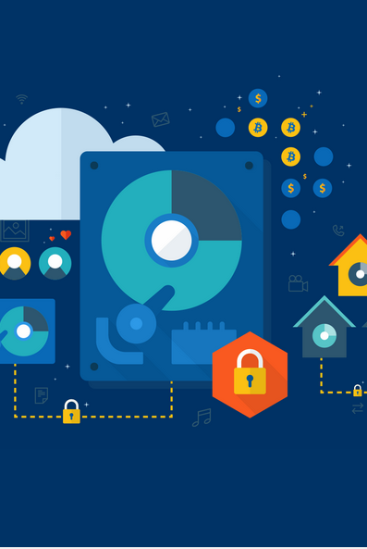
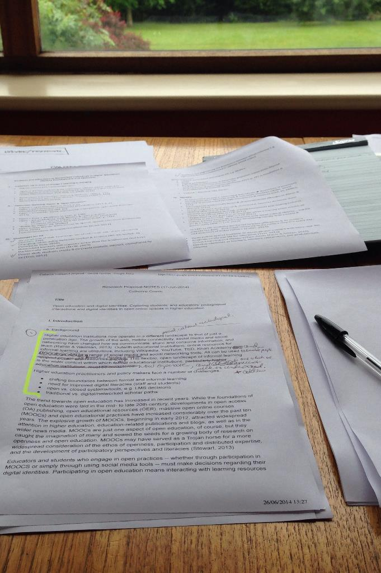
Decentralized Cloud Storage - Storj
Files are encrypted before upload to the network
Miners get paid for using their hard disk to store files
Ownership of a file is verified using the blockchain ledger

Slide 20
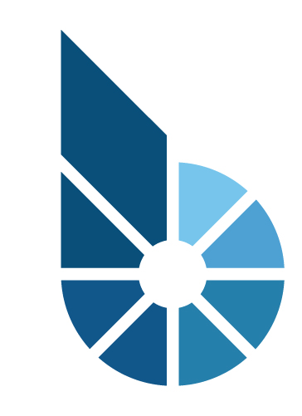
Decentralized Asset Exchange - BitShares
Buy/Sell Orders are maintained on the blockchain
Smart Contracts can be enforced: Dividends can be paid out by verifying ownership of an equity share on the blockchain at a given date
Trading fees are eliminated

Slide 21
Demonstration
Notes:
Mika and I were struck by the wide-array of applications that can be built on the platform. And at this point I should clarify: Everything we have alluded to, from enforcement of contracts, to financial transactions of any type, to escrow funds and even uber replacements, can be built today by a competent programmer.
So, Mika and I wanted to spin up a quick proof of concept to get an understanding of what can be built, how quickly and easily, and how well the application can operate. We decided a voting system would be a great candidate. Voting systems, despite their incredible importance, are not very transparent. Votes can be lost, changed, or kept in the dark. Thus, to build one on the blockchain would allow data to be published and accessible, safer, harder to fabricate, and low-cost even at the same scale as a presidential election. Thus, we present you:
FinFest Vote 2.0
Non “last years app” edition
Does it work? Lets try it out?

Slide 22
Our Company
FinFest Vote 2.0
A Distributed, Trustless, and Efficient voting platform on the blockchain
Secure
Efficient
Low-Cost

Slide 23
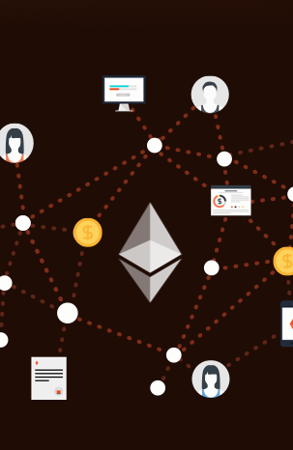
Our Platform - Ethereum
Blockchain capable of executing custom code called Smart Contracts
More resilient to downtime, censorship, fraud or third party interference than the internet

Slide 24
Ethereum in Depth
Ethereum smart contracts can call other smart contracts, allowing for code re-use
Currently, a good heuristic to use is that you will not be able to do anything on the EVM that you cannot do on a smartphone from 1999
Ether is the currency used in Ethereum
In order to prevent deliberate attacks and abuse, the Ethereum protocol charges a market-based fee per computational step
Notes:
Duplicate slide and pick standard colors green turquoise, purple

Slide 25
Ethereum in Depth contd.
The blockchain is one globally distributed VM
It has its own machine code that it uses
Multiple Programming Languages exist for it
The programming language we used was Solidity
Solidity code is compiled and then deployed
Notes:
Duplicate slide and pick standard colors green turquoise, purple

Slide 26
Solidity in Depth
Syntactically a mix between C++ and JavaScript
Two types of variables state and local, state variables are stored permanently in the blockchain
Statically typed and has value types and reference types
Libraries can also be deployed to the blockchain and be used for importing code into a contract
Contracts can inherit from other contracts
Contracts can publish events
Notes:
Duplicate slide and pick standard colors green turquoise, purple

Slide 27
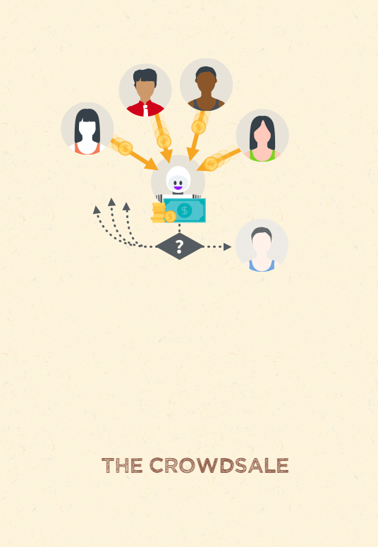
Startups on the Ethereum Blockchain
Lets kickstart our project with a crowdsale!
We will use Ethereum to create a contract that will hold people’s money until our funding goal is reached.
Depending on the outcome, the funds will either be released to us, or returned.
All without requiring a centralized arbitrator, clearing house, or needing to trust anyone.
Notes:
https://www.ethereum.org/
Sometimes a good idea takes a lot of funds and collective effort. You could ask for donations, but donors prefer to give to projects they are more certain that will get traction and proper funding. This is an example where a crowdfunding would be ideal: you set up a goal and a deadline for reaching it. If you miss your goal, the donations are returned, therefore reducing the risk for donors. Since the code is open and auditable, there is no need for a centralized trusted platform and therefore the only fees everyone will pay are just the gas fees.
So we raised some ether, what can we do now that we are funded?

Slide 28
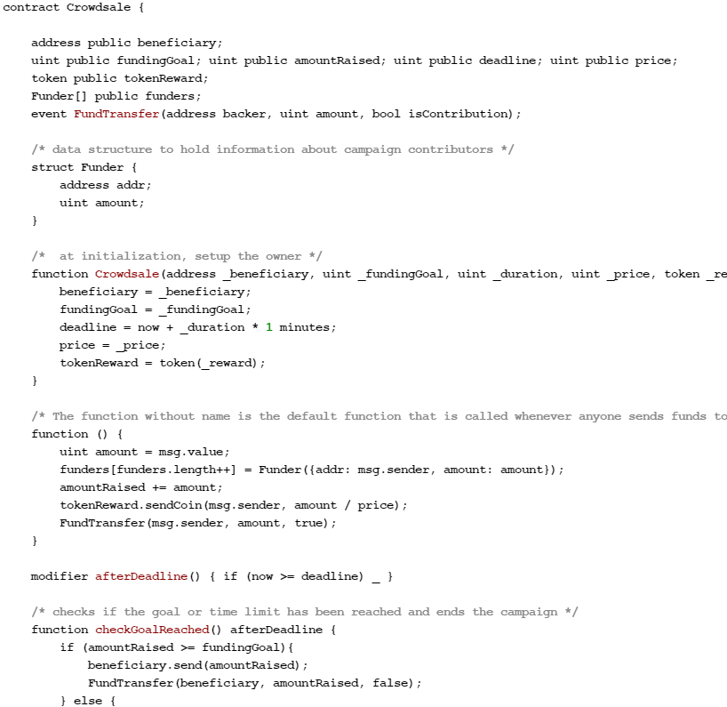
Funding in depth
Parameters:
Funding Goal
Deadline
Beneficiary
Exchange Rate of equity to Ether
… We got funded!
Now lets use the
blockchain to build our application
Notes:
Duplicate slide and pick standard colors green turquoise, purple

Slide 29
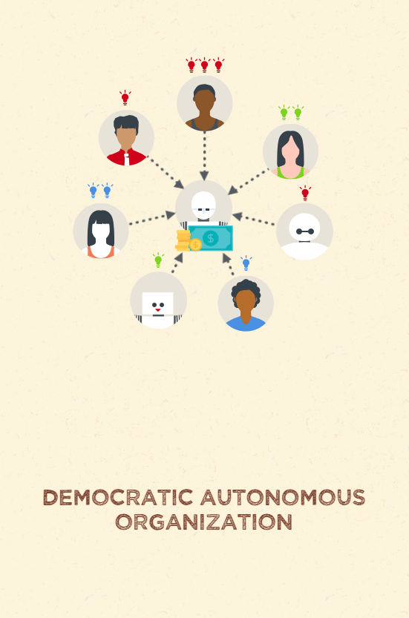
Now, let’s build FinFest Vote 2.0
We distributed shares – or voting rights – during funding.
Anyone who holds our share can vote on a proposal as needed.
Like any share, it can traded on the open market and the vote is proportional to amounts of tokens the voter holds.
The voting system can never disappear, never be frauded and cannot be controlled by anyone other than its own shareholders.
Notes:
https://www.ethereum.org/
Sometimes a good idea takes a lot of funds and collective effort. You could ask for donations, but donors prefer to give to projects they are more certain that will get traction and proper funding. This is an example where a crowdfunding would be ideal: you set up a goal and a deadline for reaching it. If you miss your goal, the donations are returned, therefore reducing the risk for donors. Since the code is open and auditable, there is no need for a centralized trusted platform and therefore the only fees everyone will pay are just the gas fees.
So we raised some ether, what can we do now that we are funded?

Slide 30
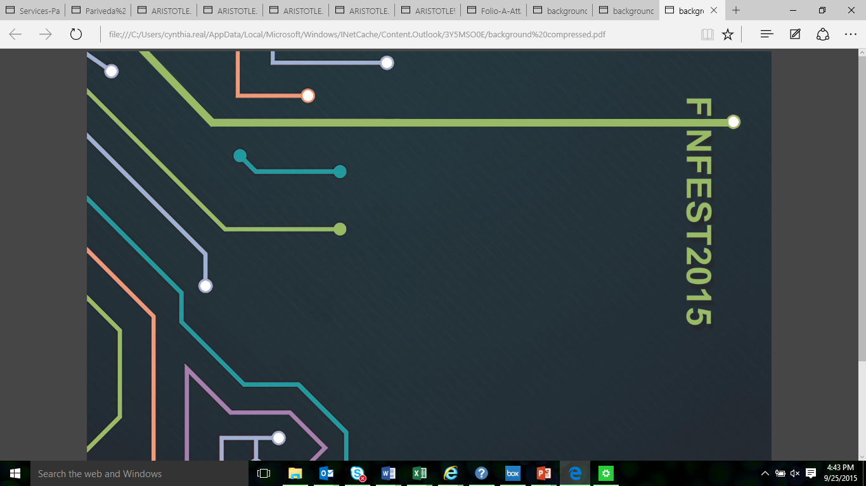
Lessons Learned

Slide 31
Lessons Learned/Summary
The blockchain is useful for creating an application that implements smart contracts: software programs the operate as intended, without censorship, fraud, or intervention.
This creates efficiencies in the marketplace, and can replace any entity that operates as an intermediary or ledger system – payment networks, stock exchanges, titles and contract enforcement, DNS.
The technology is not in its primetime yet, but it is easy to see how a number of applications may run on the blockchain due to the immense security and low overhead of the applications. It is how the Internet was supposed to work: no possibility of downtime, censorship, fraud or third party interference.
Our voting system is transparent, low-cost, incorruptible, and uncensorable.

Slide 32
Clayton
Rothschild
Mika Sanchez
Thank you.
LinkedIn: Mika Sanchez
Twitter: @ClayRothschild
LinkedIn: ClaytonRothschild
Slack: #BeyondBitcoin
s

